Slide 1

A
Mini Project - II Presentation on
“Online Chatbot based Ticketing System”
Presented by
Mr. Shriyash Amarnath Patil
Mr. Tanmay Dinesh Nagawade
Mr. Narendra Nanasaheb Khamkar
Ms. Vaishnavi Santosh Gopale
Mr. Suraj Ramdas Pansare
Under the guidance of
Dr. Sofiya Mujawar
Department of Information Technology
School of Engineering & Technology
D.Y. Patil University, Pune.
Academic Year 2024-25.

Slide 2
Presentation Outline
Introduction
Literature Survey
Methodology(Hardware & Software)
Schematic
Flowchart /Algorithm
Simulation Results (if any)
Applications
Conclusions
References

Slide 3
Introduction
The project aims to design and develop an intelligent ticketing system using a chatbot interface. The system will be capable of understanding user queries, providing information, and automating ticketing processes

Slide 4
Introduction (Cont’d…..)
1
Need for Automation
Traditional ticketing systems often involve manual processes, which can be time-consuming and prone to errors.
2
Enhanced User Experience
A chatbot interface can provide a more user-friendly experience, allowing customers to access ticketing services easily.
3
Real-time Support
The chatbot can provide instant support to users, addressing inquiries and resolving issues in real-time.

Slide 5
Literature Survey
S.No | Paper Title & Authors | Methodology | Key Contributions | Limitations | Year
1. | A Survey on Chatbot Implementation in Customer Support Systems | Literature review of chatbot architectures for customer support. Comparison of frameworks like Dialogflow and Rasa. | Provides a high-level overview of chatbot architecture for automating ticket creation and management in customer support systems. | Lacks detailed implementation and real-world application data. | 2020
2. | Automating IT Support Ticket Categorization with Machine Learning | Machine learning-based ticket classification using NLP. Focus on supervised learning models for IT support ticket categorization. | Demonstrates the use of NLP for classifying and routing support tickets, improving efficiency in ticket handling. | No focus on the chatbot interface or user interaction model. Limited to ticket classification. | 2019
3. | End-to-End Framework for Building Conversational Agents for Customer Support | Developed an end-to-end architecture for conversational agents with an integration model for customer support systems. | Provides a complete framework from chatbot design to deployment, with a focus on real-time ticket handling. | Primarily focused on architecture without extensive performance benchmarks. | 2021

Slide 6
S.No | Paper Title & Authors | Methodology | Key Contributions | Limitations | Year
4. | Chatbots in Business Processes: A Case Study on Ticketing Systems | Case study methodology exploring the integration of chatbots into ticketing systems and other business processes. | Detailed insights on how chatbots can improve efficiency in ticket handling and customer interaction processes. | Based on a single case study, so generalizability to other industries may be limited. | 2020
5. | Leveraging AI Chatbots for IT Help Desk Automation: A Case Study | AI-driven chatbot implementation for automating help desk functions, including ticket generation and query resolution. | Proposes AI chatbot solutions that reduce human intervention in help desk ticketing systems and automate ticket lifecycle processes. | Focuses on IT-specific help desk automation without generalization to other support systems. | 2019
6. | Usability of Conversational Agents for IT Ticketing Systems | Usability testing of chatbots in IT ticketing systems, focusing on user experience and performance. | Highlights user experience challenges in using chatbots for IT ticketing and suggests improvements for user satisfaction. | Limited scope of chatbot functions—focused mainly on usability rather than full integration with ticketing systems. | 2020

Slide 7
Methodology
The methodology for developing an online chatbot-based ticketing system involves several key steps. First, requirements gathering is conducted to understand the specific needs of users and the organization, such as the types of issues commonly addressed and preferred ticket management workflows. Next, chatbot design and development take place, leveraging natural language processing (NLP) to enable the bot to understand user queries and guide them through the ticketing process. Integration with an existing ticket management system or CRM is crucial to automate ticket creation, assignment, and tracking.

Slide 8
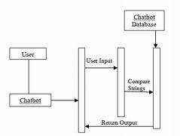
Schematic -

Slide 9
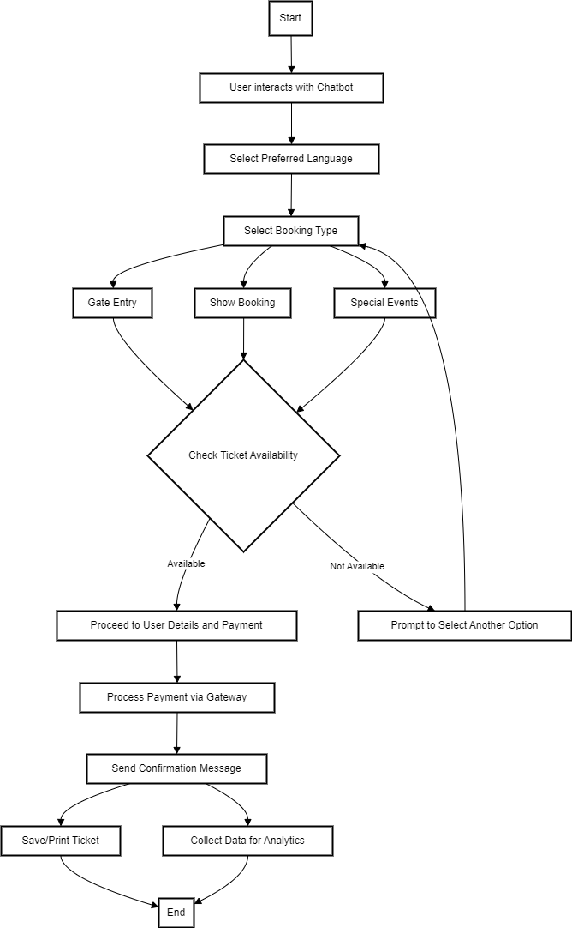
Flowchart / Algorithm

Slide 10
Applications
1
Event Ticketing
2
Travel Booking
Streamline the purchase of tickets for concerts, sporting events, and other entertainment.
Seamlessly reserve flights, hotels, and rental cars through an intuitive chat interface.
3
Public Transportation
4
Customer Service
Easily purchase and manage public transportation tickets, from subway to buses.
Provide instant and personalized support to customers, resolving issues quickly.

Slide 11
Conclusion
1
2
3
4
Efficiency
Personalization
Accessibility
Cost Savings
Chatbot-based ticketing systems simplify ticket purchase and management, saving time and effort.
Tailored recommendations based on user preferences and past purchases enhance the experience.
Easy-to-use chat interfaces are accessible to a wide range of users, regardless of technical skills.
Automation reduces operational costs for ticketing organizations, improving profitability.

Slide 12
References
Chatbot Frameworks and Architecture:
Paper Title: "A Survey on Chatbot Implementation in Customer Support Systems"
  Authors: Abdellatif El Meslouhi, Mohamed Khamlichi, Mohamed Abderrahim.
Natural Language Processing (NLP) for Ticket Classification:
Paper Title: "Automating IT Support Ticket Categorization with Machine Learning"
  Authors: Chirag Patel, Rakesh Sharma, and Seema Shah.
End-to-End Chatbot Design for Customer Service:
Paper Title: "End-to-End Framework for Building Conversational Agents for Customer Support"
  Authors: Karthik Ramesh, Nikhil Choudhary.
Integration of Chatbots in Business Processes:
Paper Title: "Chatbots in Business Processes: A Case Study on Ticketing Systems"
  Authors: Marco Pichler, Josef Dorn, and Astrid Böhm.

Slide 13
Thank you!

